Slide 1
FINAL PROJECT SQL STUDY CASE
Kelompok D7 - FinPro Data Anlysis Batch 26

Slide 2


Our Team
Muhammad Awaluddin
Adin Nugroho
Milza N Rosad
Epifania N A S
Della Silvi F
Niswatul Rizkiah
Edwi Yolanda Husna
Tiara Fitriannisha

Slide 3
Our Contents
01
02
03
04
Data Overview
Table Scheme
Question No. 1
Question No. 2
05
06
07
Question No. 3
Question No. 4
Question No. 5

Slide 4
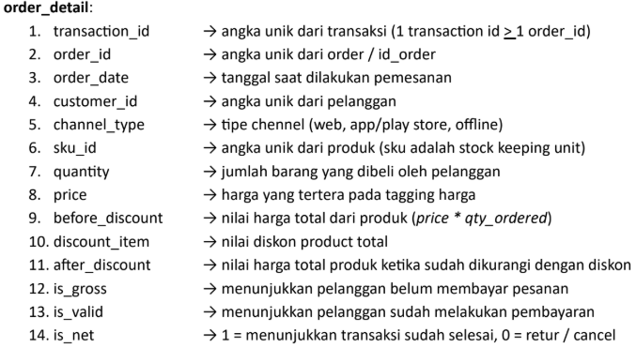
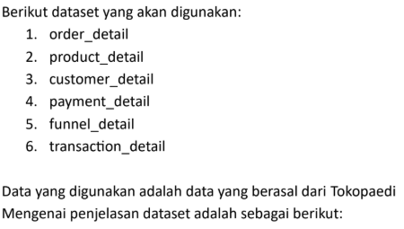
Data Overview

Slide 5
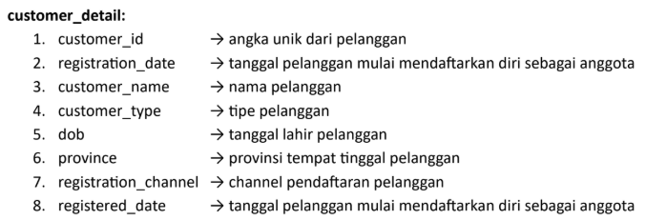
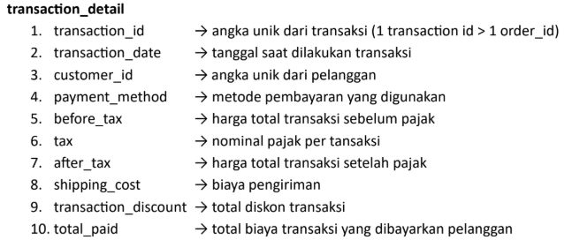
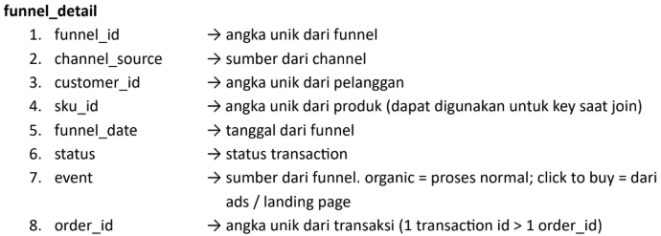

Data Overview

Slide 6
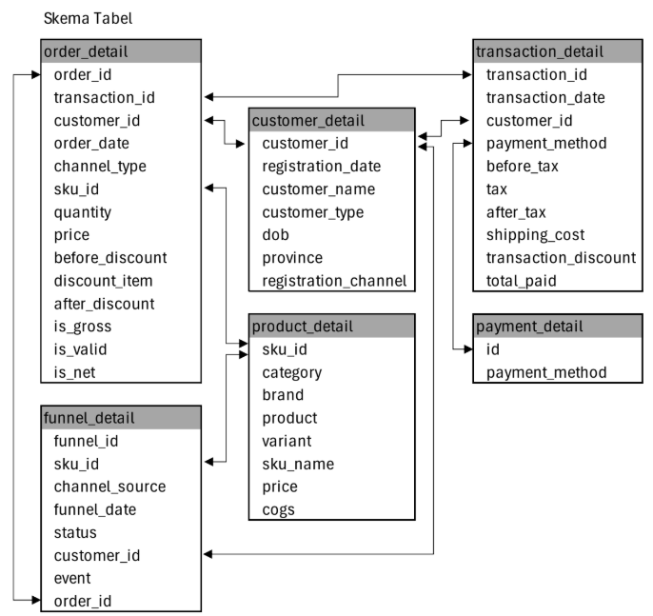
Data Overview

Slide 7
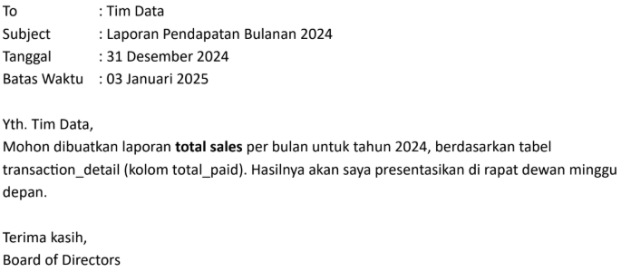
Question
No. 1

Slide 8
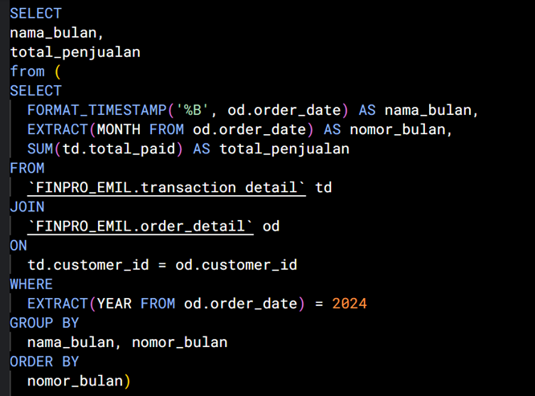
Question
No. 1
SQL Query

Slide 9
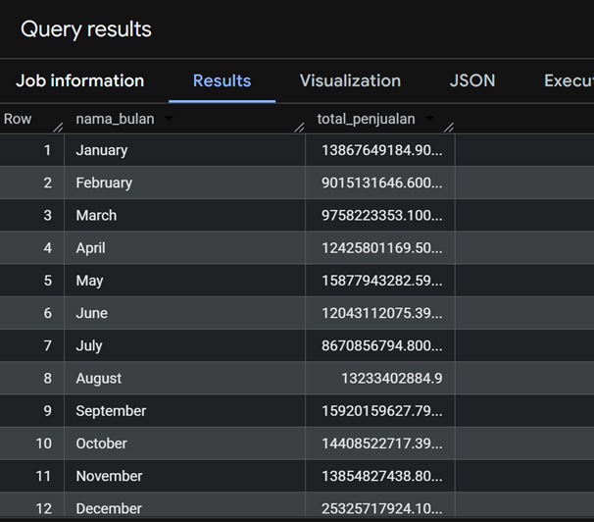
Question
No. 1
Result

Slide 10
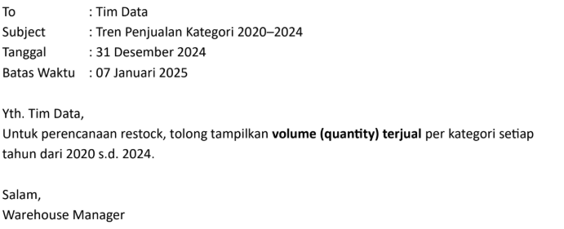
Question
No. 2

Slide 11
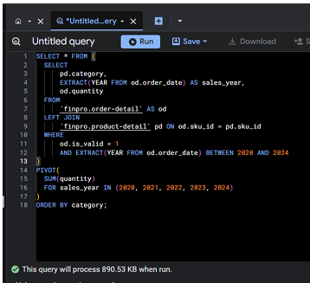
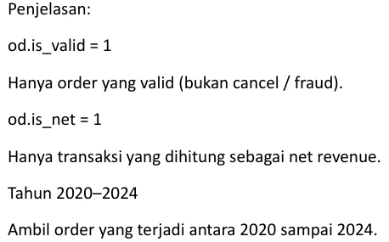
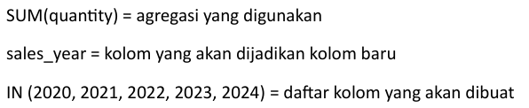
Question
No. 2
SQL Query

Slide 12
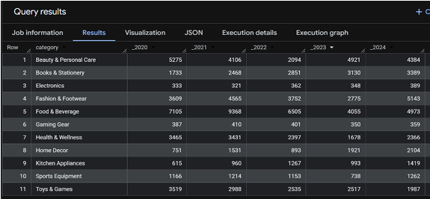
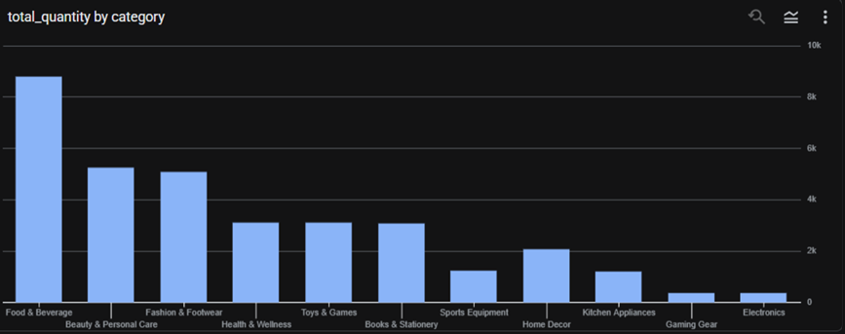
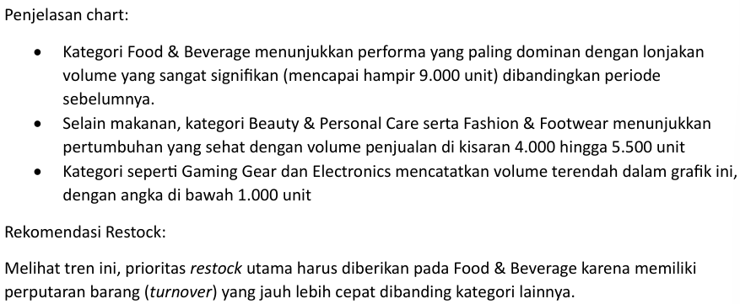
Result
Question
No. 2

Slide 13
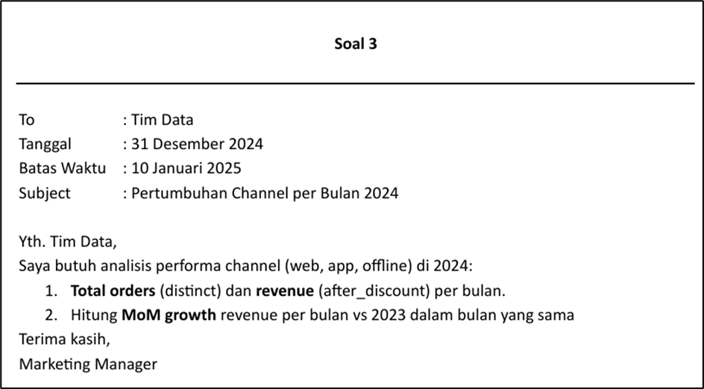
Question
No. 3

Slide 14
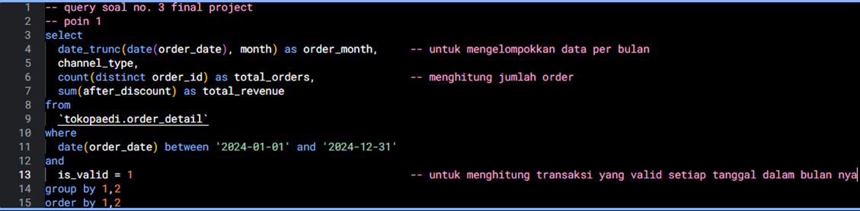
Question
No. 3
SQL Query - Point 1

Slide 15
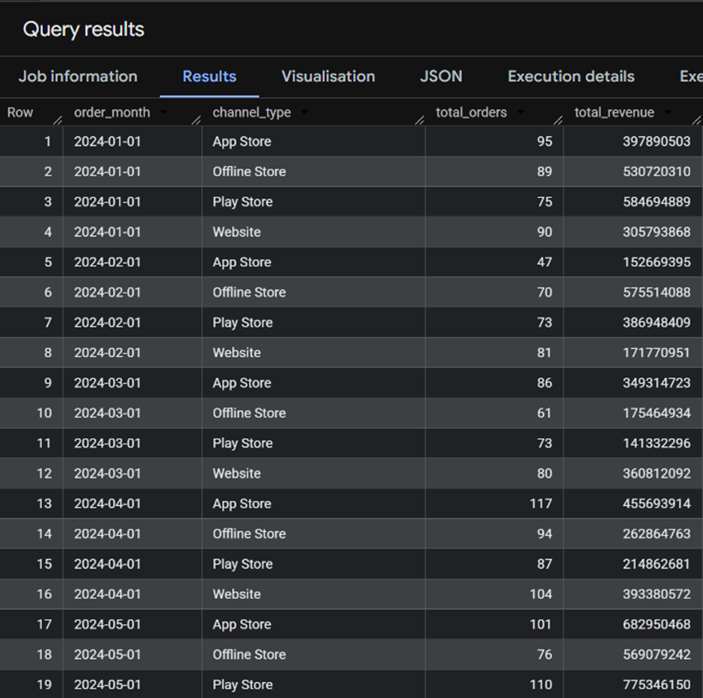
Question
No. 3
Result - Point 1

Slide 16
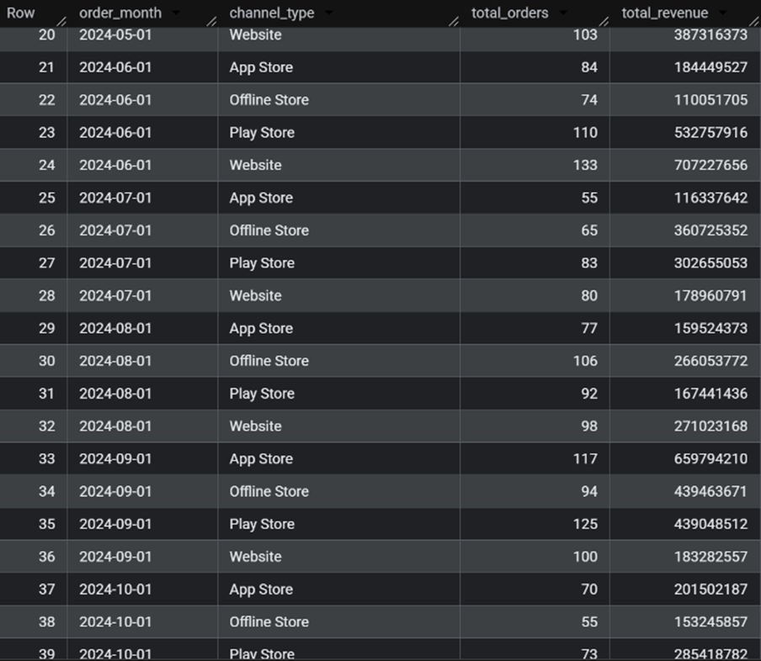
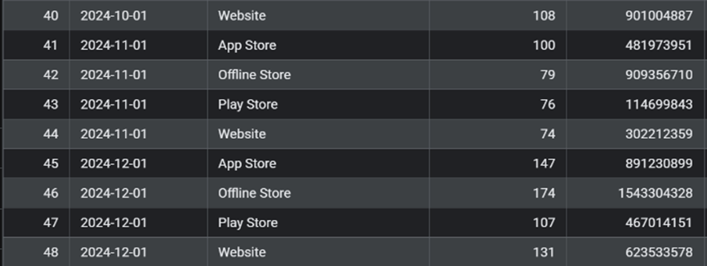
Result - Point 1
Question
No. 3

Slide 17
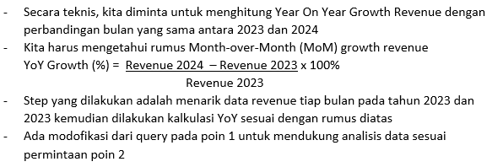
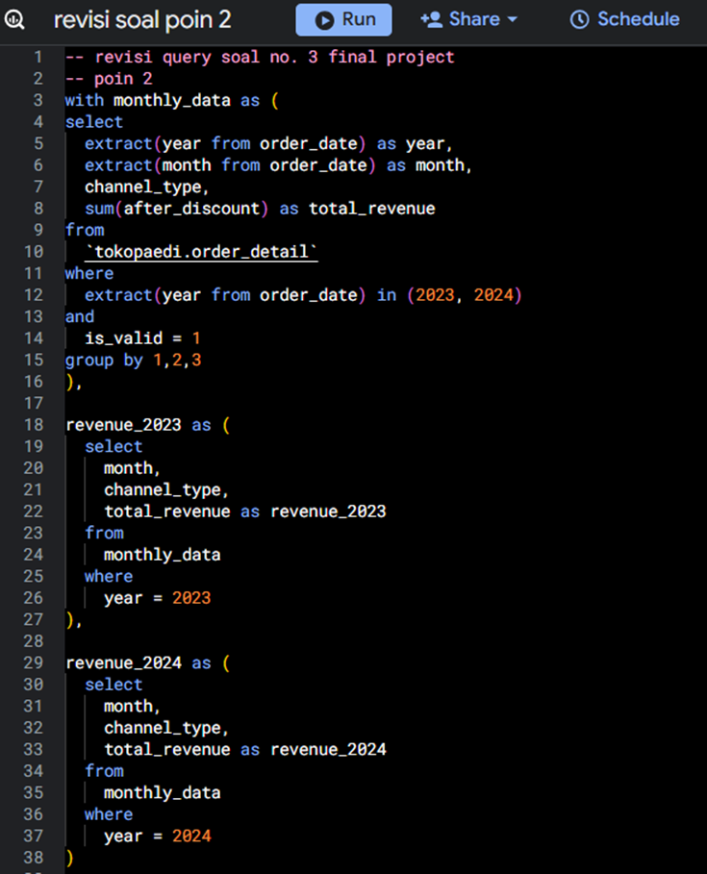
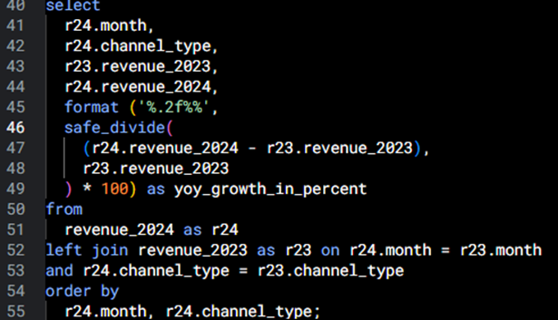
SQL Query - Point 2
Question
No. 3

Slide 18
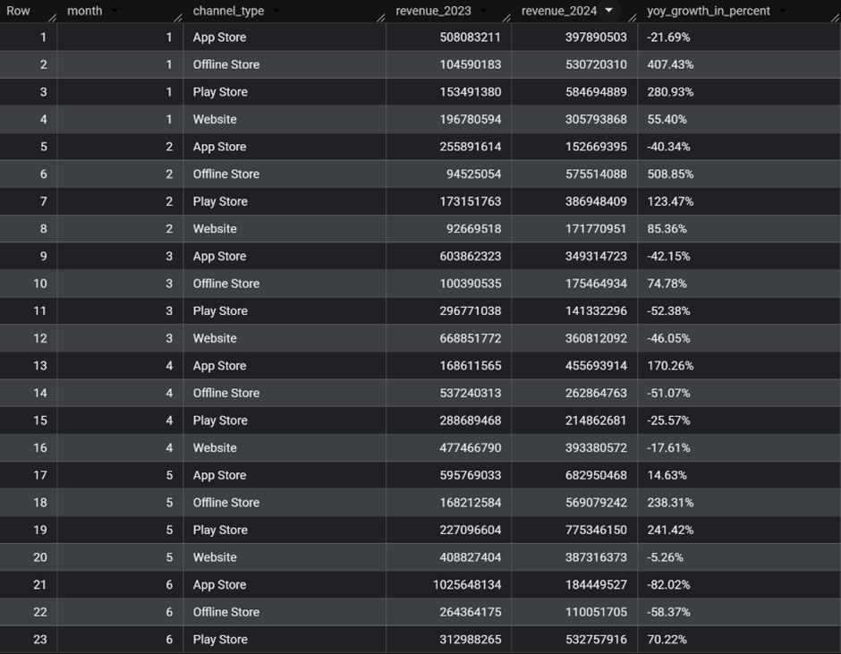
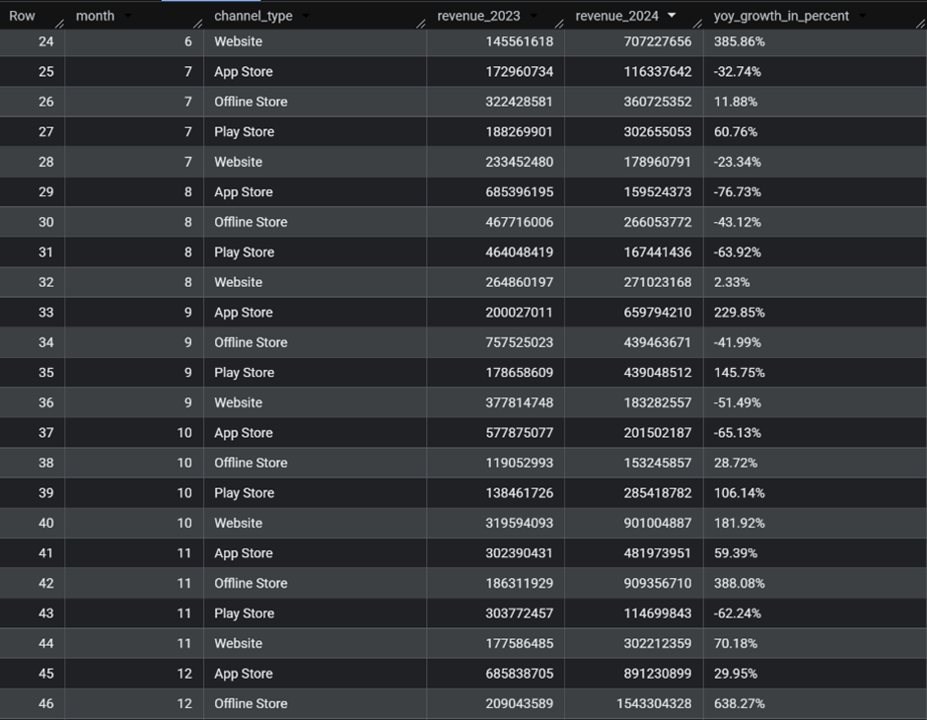
Result - Point 2
Question
No. 3

Slide 19
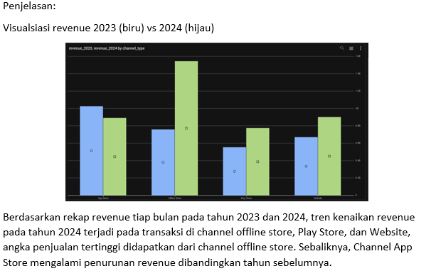
Result - Point 2
Question
No. 3

Slide 20
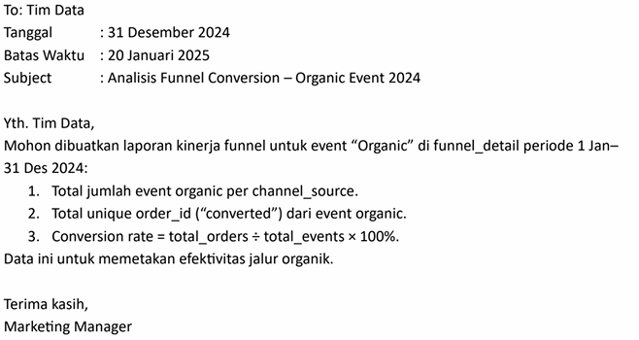
Question
No. 4

Slide 21
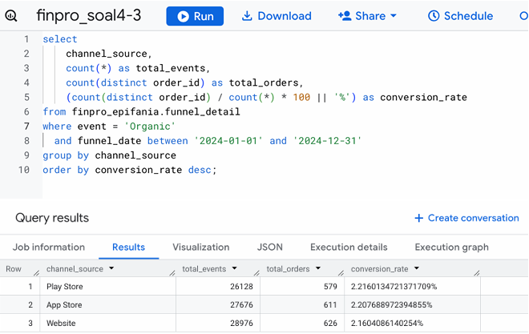

SQL Query and Result
Question
No. 4

Slide 22
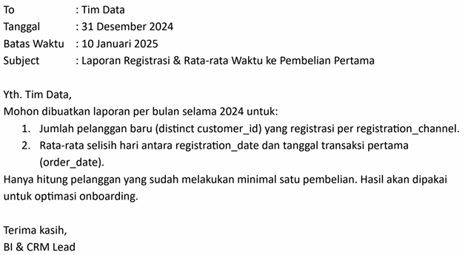
Question
No. 5

Slide 23
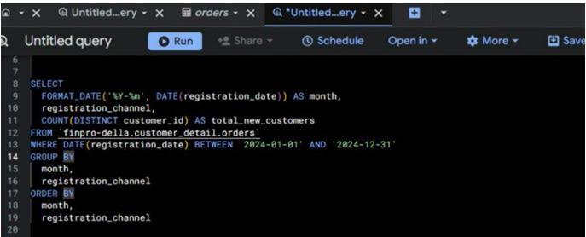
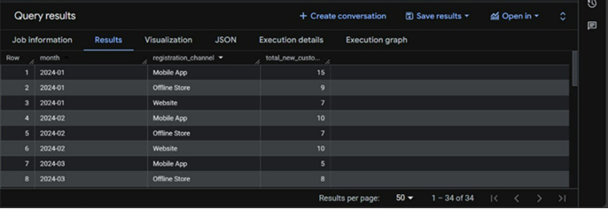
SQL Query and Result - Point 1
Question
No. 5

Slide 24
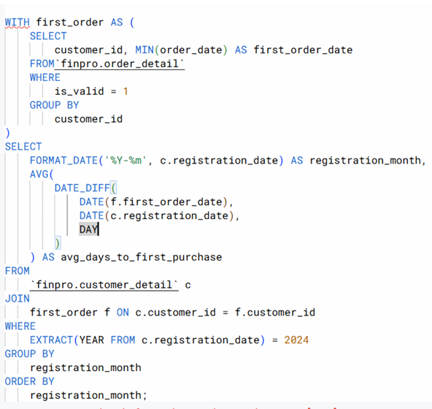
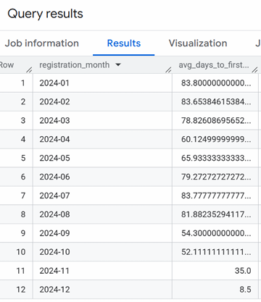
SQL Query and Result - Point 2
Question
No. 5

Slide 25
THANK YOU

